Slide 1


University of Basrah
Al-Zahraa Medical College
Ministry of higher Education and Scientific Research
Academic year 2025-2026
5th year
REPRODUCTIVE
Lecture
Duration : 1 hour
GENITAL PROLAPSE
Presented by
Dr.HAWRA MAITHAM AHMED
Block staff:
Dr.Marwa Sadik
DrHeba salman
Dr.Safa keffah
Dr.Nisreen muhssen
GYNAECOLOGY 20th
EDITION by Ten Teachers

Slide 2
University of Basrah
Al-Zahraa Medical College
Ministry of higher Education and Scientific Research
LEARNING OBJECTIVES
*Definition of prolapse
• Understand the anatomy of supporting ligaments and fascia of the female pelvic organs.
• Appreciate the relationships between anatomical prolapse and functional symptoms, including urinary, bowel and sexual dysfunction.
*Types and degree of prolapse
• Learn how to assess the patient with prolapse by means of history, examination and relevant investigations.
• Understand the principles of treatment of prolapse and be able to describe the effectiveness of each treatment.

Slide 3
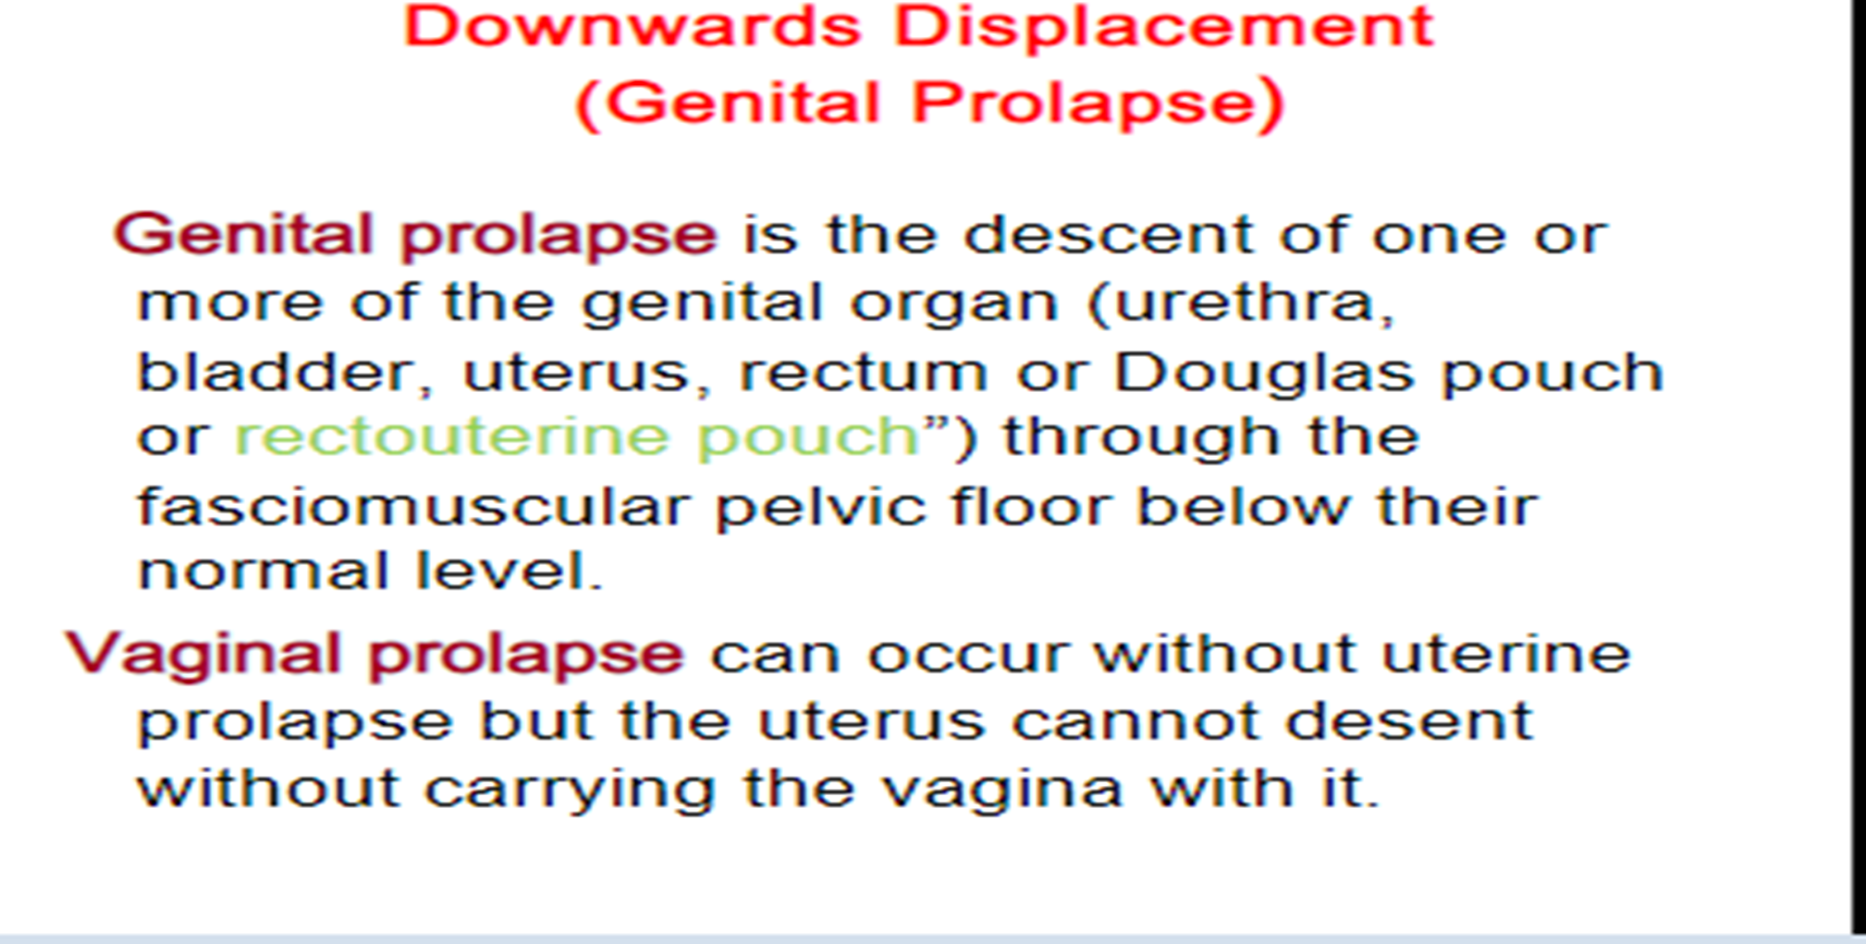
University of Basrah
Al-Zahraa Medical College
Ministry of higher Education and Scientific Research

Slide 4
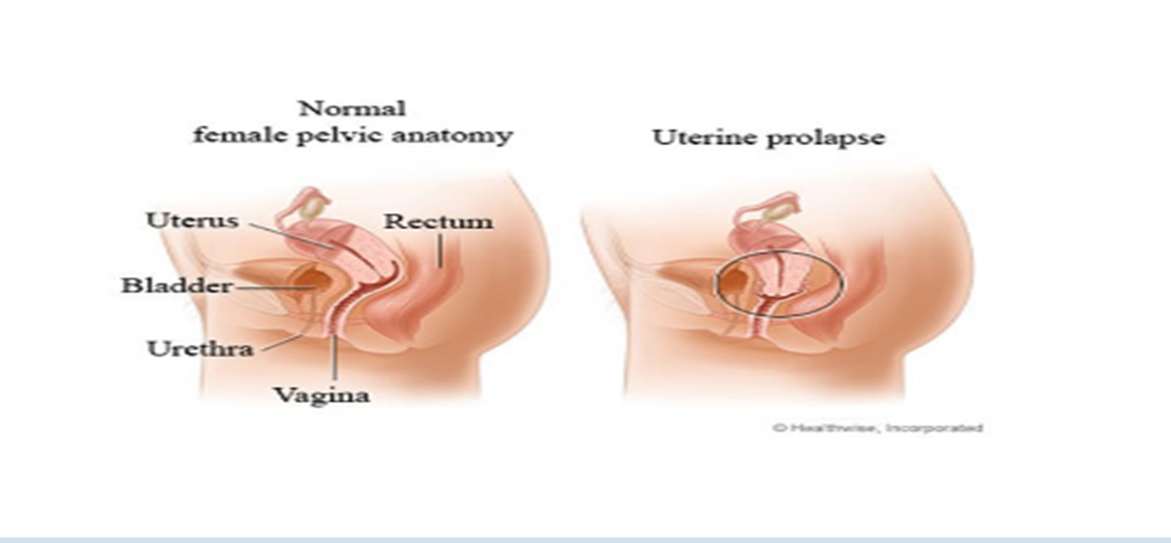
University of Basrah
Al-Zahraa Medical College
Ministry of higher Education and Scientific Research

Slide 5
University of Basrah
Al-Zahraa Medical College
Ministry of higher Education and Scientific Research
Relevant anatomy
Uterovaginal prolapse is caused by failure of the interaction between the levator ani muscles and the ligaments and fascia that support the pelvic organs.
The levator ani muscles are puborectalis, pubococcygeus and iliococcygeus. They are attached on each side of the pelvic side wall from the pubic ramus anteriorly over the obturator internus fascia to the ischial spine to form a bowl-shaped muscle filling the pelvic outlet and supporting the pelvic organs prevent excessive loading of the ligaments and fascia.

Slide 6
University of Basrah
Al-Zahraa Medical College
Ministry of higher Education and Scientific Research
There are three levels of supporting ligaments and fascia :
1-Level 1 (apical) support is provided by the uterosacral ligaments, which attach the cervix to the sacrum. Defects in level 1 support can be seen on examination by the descent of the uterus within the vagina. In women who have previously undergone hysterectomy, level 1 support defects will manifest as vaginal vault prolapse.
2-Level 2 support is provided by the fascia that surrounds the vagina, both anteriorly and posteriorly, lying between the vagina and the bladder (pubocervical fascia) or rectum (rectovaginal fascia). Defects in the fascia providing level 2 support will lead to prolapse of the vaginal wall into the vaginal lumen (causing anterior or posterior vaginal prolapse).

Slide 7
University of Basrah
Al-Zahraa Medical College
Ministry of higher Education and Scientific Research
3-Level 3 support is provided by the fascia of the posterior vagina, which is attached at its caudal end to the perineal body. The perineal body is a dense connective tissue mass underneath the lower third of the posterior vaginal wall and is the insertion of the posterior vaginal fascia, fibres of levator ani and the transverse perineal muscles.
Defects of the perineal body usually cause the development of lower posterior vaginal wall prolapse, but the loss of the perineal body increases the size of vaginal opening and therefore predisposes to anterior vaginal prolapse as well

Slide 8
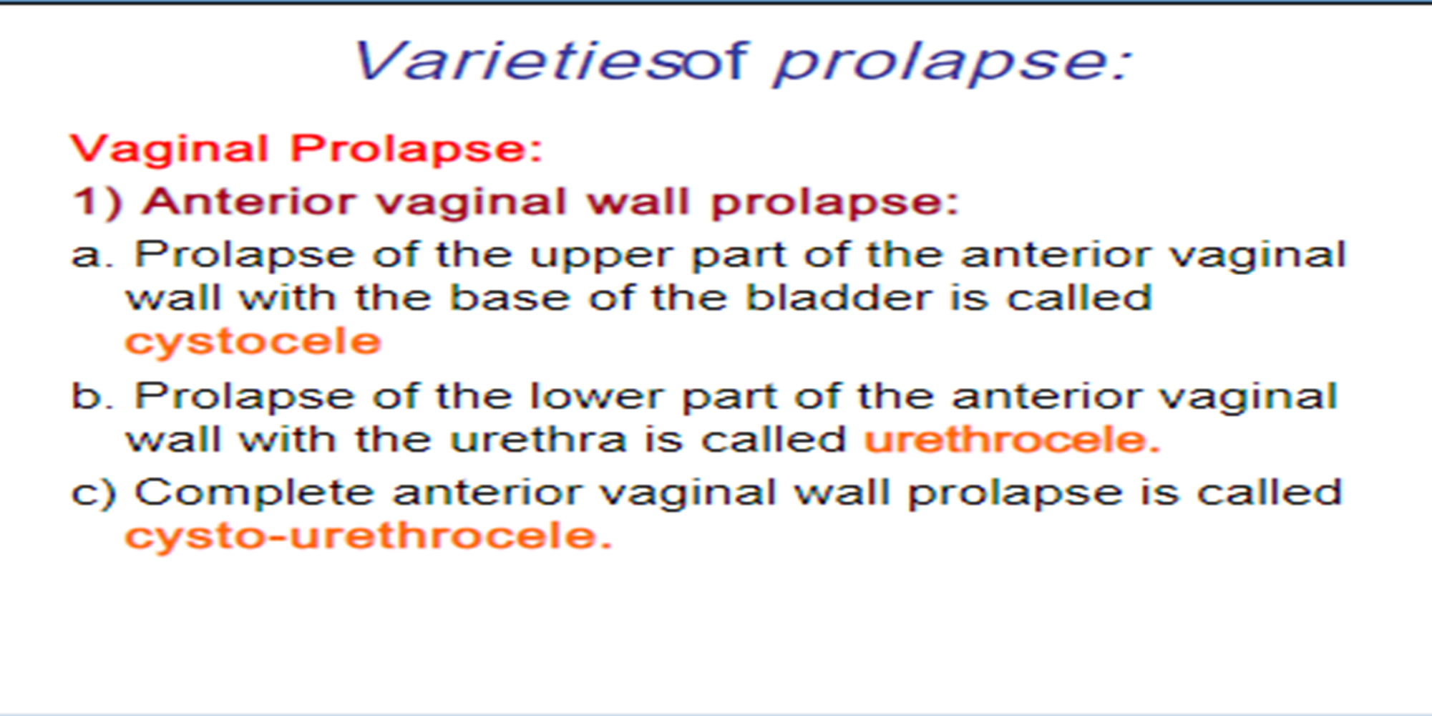
University of Basrah
Al-Zahraa Medical College
Ministry of higher Education and Scientific Research

Slide 9
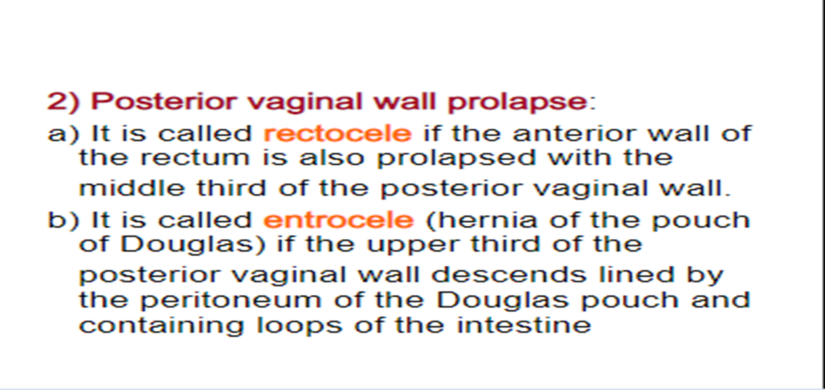
University of Basrah
Al-Zahraa Medical College
Ministry of higher Education and Scientific Research

Slide 10
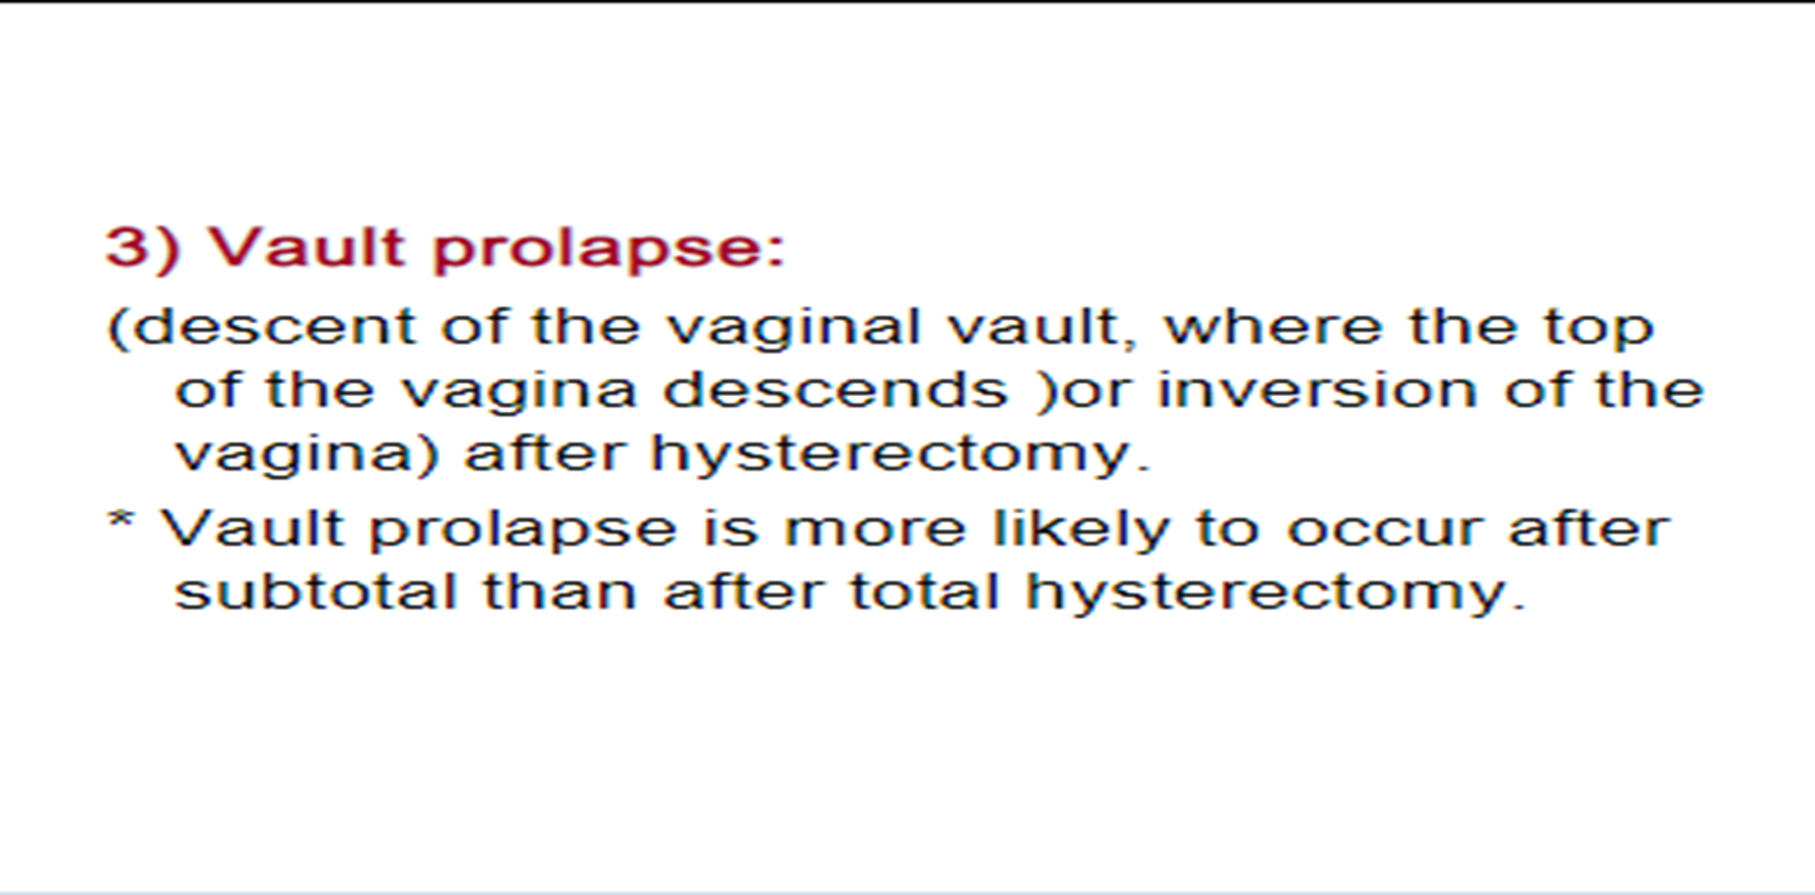
University of Basrah
Al-Zahraa Medical College
Ministry of higher Education and Scientific Research

Slide 11
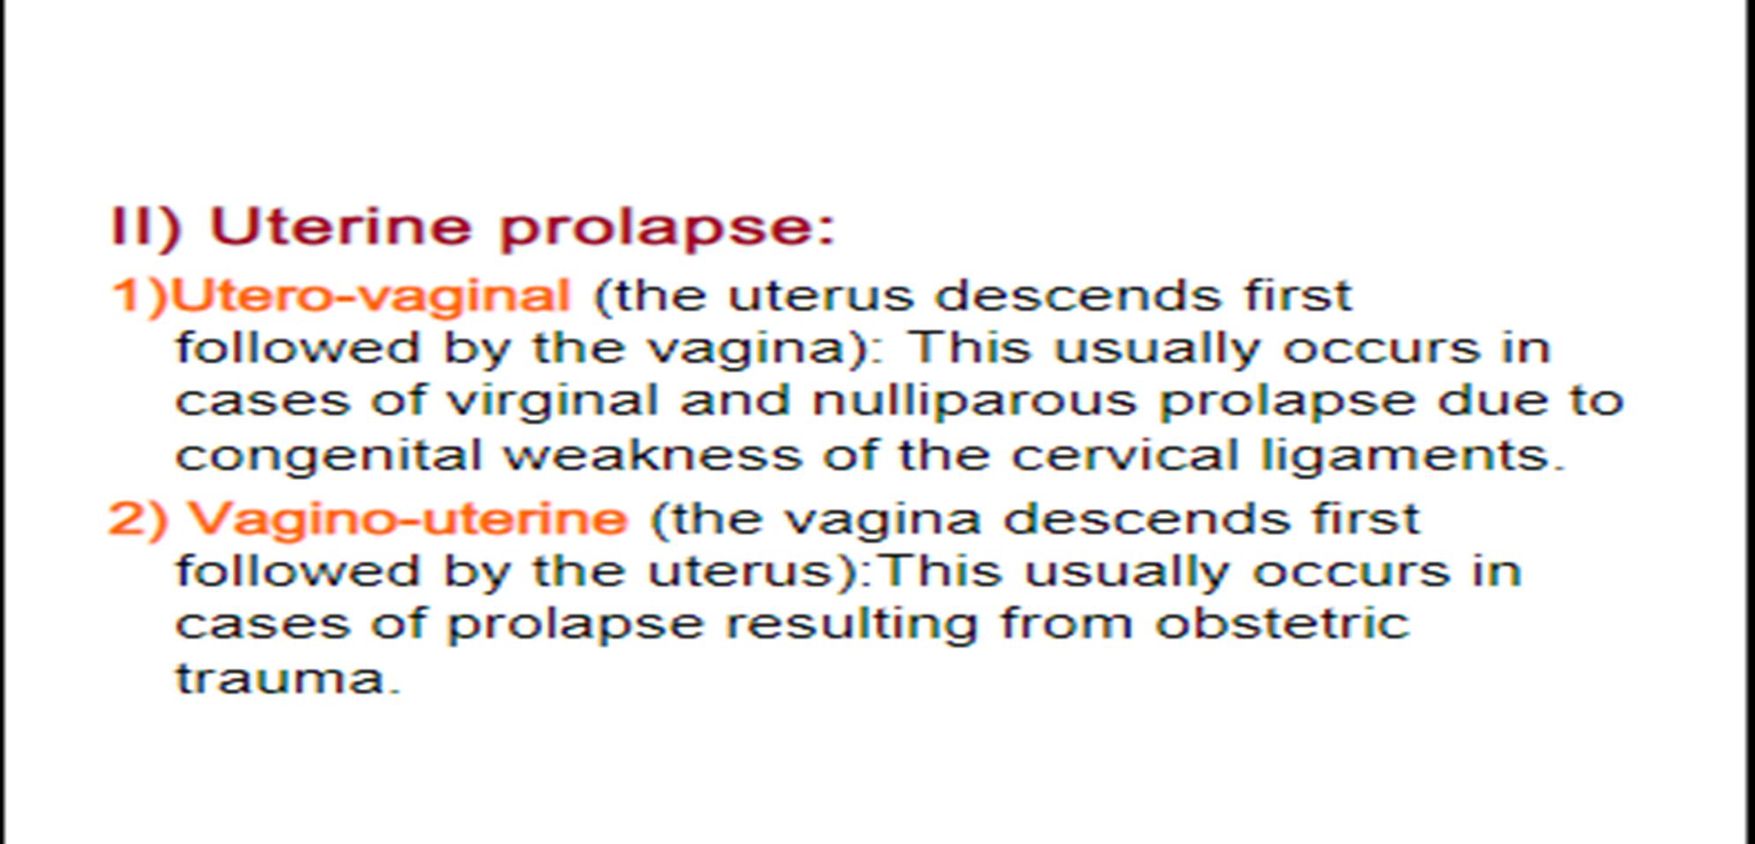
University of Basrah
Al-Zahraa Medical College
Ministry of higher Education and Scientific Research

Slide 12
University of Basrah
Al-Zahraa Medical College
Ministry of higher Education and Scientific Research
Risk factors
• Multiparity
• Forceps delivery
• Perineal trauma.
• Long labour
• Birthweight >4 kg.
• Increasing age.
• Postmenopause.
• Obesity
• Connective tissue disease.

Slide 13
University of Basrah
Al-Zahraa Medical College
Ministry of higher Education and Scientific Research
Clinical assessment of prolapse :
HISTORY :The history should elicit the presenting symptom which result either directly due to the prolapsed organ or indirectly due to organ dysfunction secondary to displacement from the anatomical position .These symptoms include :
1-sensation of vaginal bulge, heaviness or a visible protrusion at or beyond the introitus
2-lower abdominal or back pain, or a dragging discomfort relieved by lying or sitting
3-difficulty in voiding urine or emptying the bowel
4-sensations of incomplete emptying of bladder or rectum.
5-Urinary or faecal incontinence may also be present
6-difficulty achieving penetration, pain or discomfort during intercourse and loss of sensation and difficulty achieving orgasm
7-vaginal bleeding from a prolapse that is external and becomes ulcerated

Slide 14
University of Basrah
Al-Zahraa Medical College
Ministry of higher Education and Scientific Research
Examination : should ideally be done in the lithotomy position with a Sims speculum to allow full assessment of the degree of prolapse and to assess how much descent of the cervix and uterus is present
STAGES OF PROLAPSE
• Stage I where the prolapse does not reach the hymen.
• Stage II where the prolapse reaches the hymen.
• Stage III when the prolapse is mostly or wholly outside the hymen. When the uterus prolapses wholly outside this is termed procidentia.
Investigation:
1-anaesthetic preassessment
2-urodynamic assessment 3-functional tests of the lower bowel, which may include endoanal ultrasound to check for anal sphincter defects, rectal manometry, flexible sigmoidoscopy and a defaecating proctogram.

Slide 15
University of Basrah
Al-Zahraa Medical College
Ministry of higher Education and Scientific Research
Treatment for prolapse
A- Conservative treatment:
1-pelvic floor muscle exercises : will reduce the symptoms of prolapse and may reduce prolapse progression in women with mild/moderate prolapse. and for women who are keen to avoid surgical treatment, this can be an effective first step, although there is less evidence that pelvic floor exercise will reduce the anatomical extent of the prolapse and it is unlikely to be helpful for women whose prolapse is beyond the vaginal introitus.

Slide 16
University of Basrah
Al-Zahraa Medical College
Ministry of higher Education and Scientific Research
2-use of supportive vaginal pessaries :can be very effective at relieving symptoms and has the advantage of avoiding surgery and the associated risks, which can be extremely useful in the medically unfit and elderly. Ring pessaries are usually tried first, but an intact perineal body is necessary for these to be retained. Shelf pessaries, Gelhorn pessaries and others are useful for women with deficient perineal bodies. It is usual practice to replace apessary every 6 months and to examine the patient for signs of vaginal ulceration
Complications are uncommon and usually minor (bleeding, discharge), although rarely the pessary can become incarcerated, requiring general anesthesia to remove, and rare cases of rectovaginal or vesicovaginal fistula formation have been reported. Sexual intercourse remains theoretically possible with a well-placed ring pessary, but not with the others, so would not generally be suitable for women who are sexually active.

Slide 17
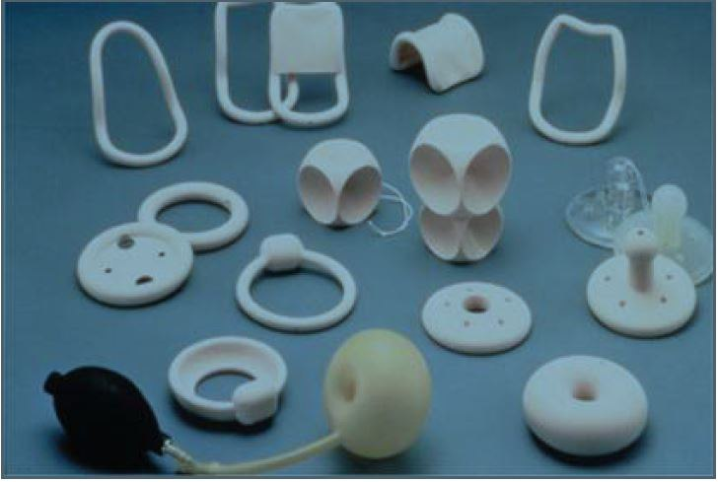
University of Basrah
Al-Zahraa Medical College
Ministry of higher Education and Scientific Research

Slide 18
University of Basrah
Al-Zahraa Medical College
Ministry of higher Education and Scientific Research
B-Surgical treatment
can be offered if conservative treatments have failed or if the patient chooses surgery and it include :
1- Vaginal approach:
*Anterior vaginal repair (anterior colporrhaphy)
*posterior vaginal repair (posterior colporrhaphy)
*vaginal repair with polypropylene mesh usually for recurrent prolapse (Mesh repair carries the risk of later erosion and need for removal)
2-Abdomenal approach :
*sacrocolpopexy is an option that will provide excellent, durable long-term cure.

